Slide 1

Finding the best time to Purchase a Car in Singapore
Insights & Recommendations

Slide 2






Agenda
Objective
Summary
EDA
Background
Business Recommendation
Seamless arrival, a life's odyssey propelled by an unwavering resolve, paving the way for fulfillment's embrace.

Slide 3


Singapore Vehicle System
CAR
Certificate of Entitlement (COE)
1. Fixed price range
1. Varies price range

Slide 4
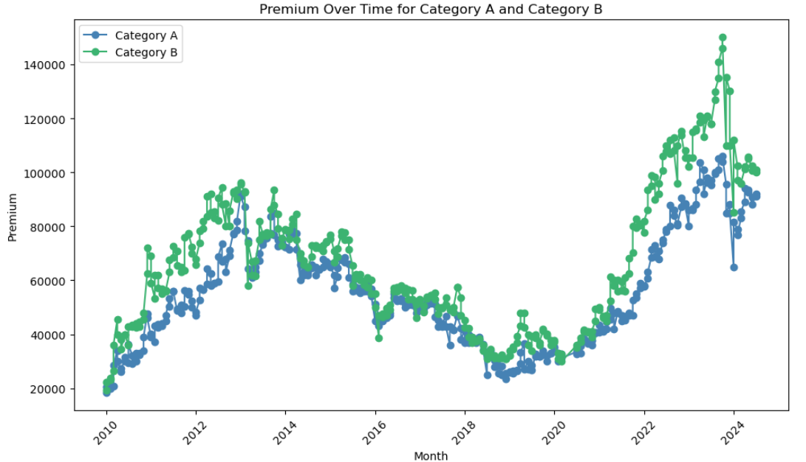
Change in COE Premium YOY
$300,000!
$112,000
$94,000
Cat B: 484%
Cat A: 408%
$19,000
~$200,000
$19,000

Slide 5
Background
Certificate of Entitlement (COE)
A license required to own a vehicle in Singapore, aimed at controlling the vehicle population
Purpose
To regulate the vehicle population in the country's limited land
Different Categories
A: Cars ≤1,600cc/130bhp (Cat A)
B: Cars >1,600cc/130bhp (Cat B)
C: Goods vehicles & buses
D: Motorcycles,
E: Open category
How it works?
Interested buyers participate in a bidding process to secure a COE, which is only valid for 10 years

Slide 6
Objective
Stakeholders
Problem Statement
Interested buyer that wish to own a car in Singapore
COE prices have been fluctuating over the years. Interested buyers have to pay a very high premium to own a car.
Key Questions
Approach
1. Any correlations between quota (supply) and COE premium?
1. EDA
2. Trends & hypothesis testing
2. Any correlations between period of purchase and COE premium?
3. Identify the best time to purchase a car in Singapore

Slide 7

Exploratory
Data Analysis

Slide 8
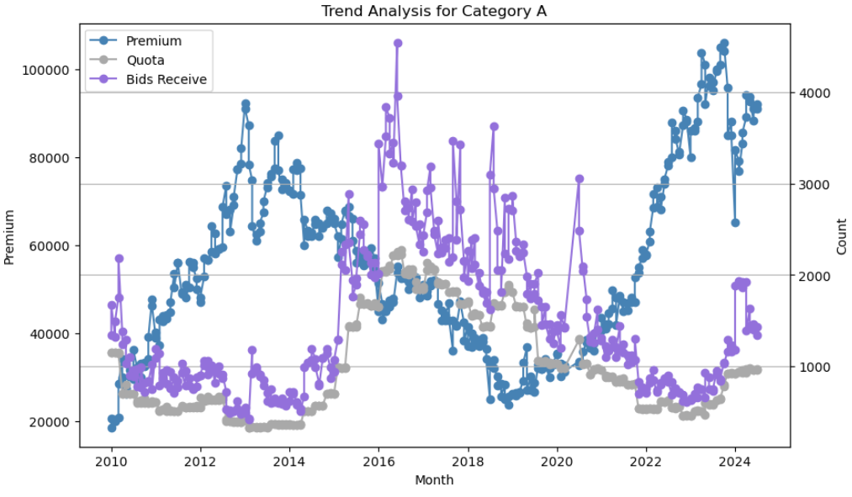
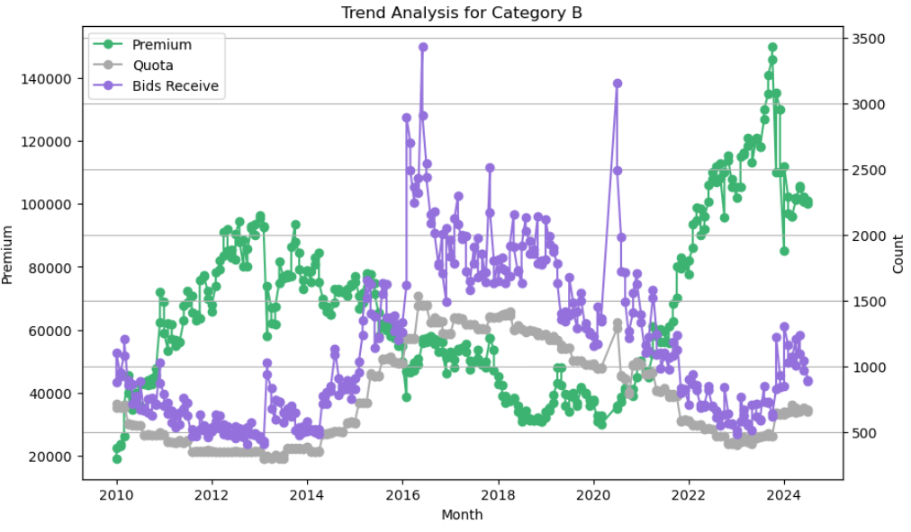
Demographics of Demand, Supply & Premium
High Premium
High Premium
High Supply
High Supply
Low Supply
Low Premium
Low Supply
Low Premium

Slide 9

Any correlations between quota (supply) and COE premium?

Slide 10
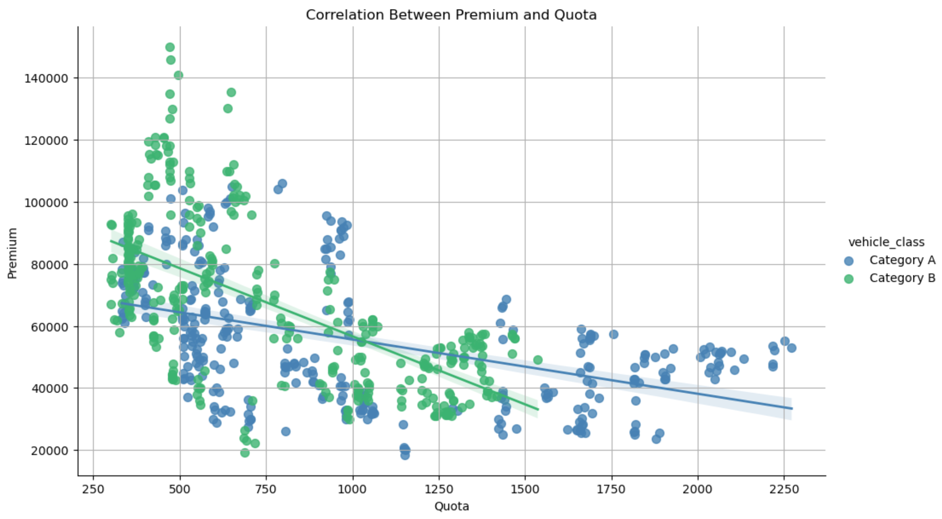
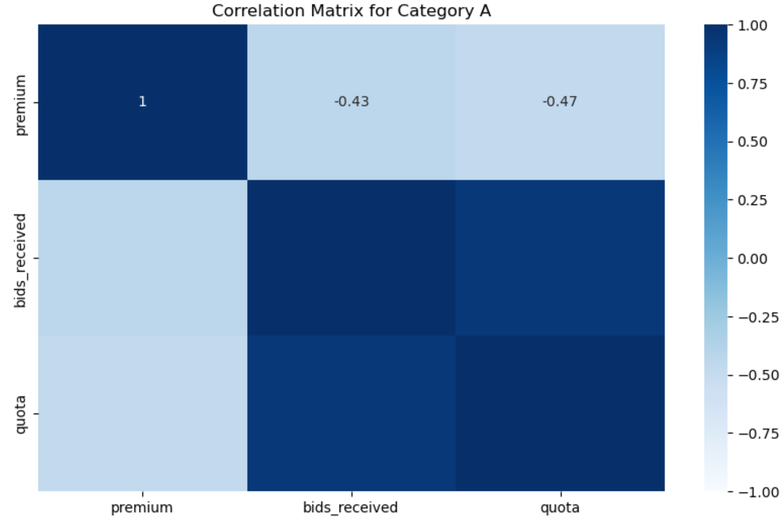
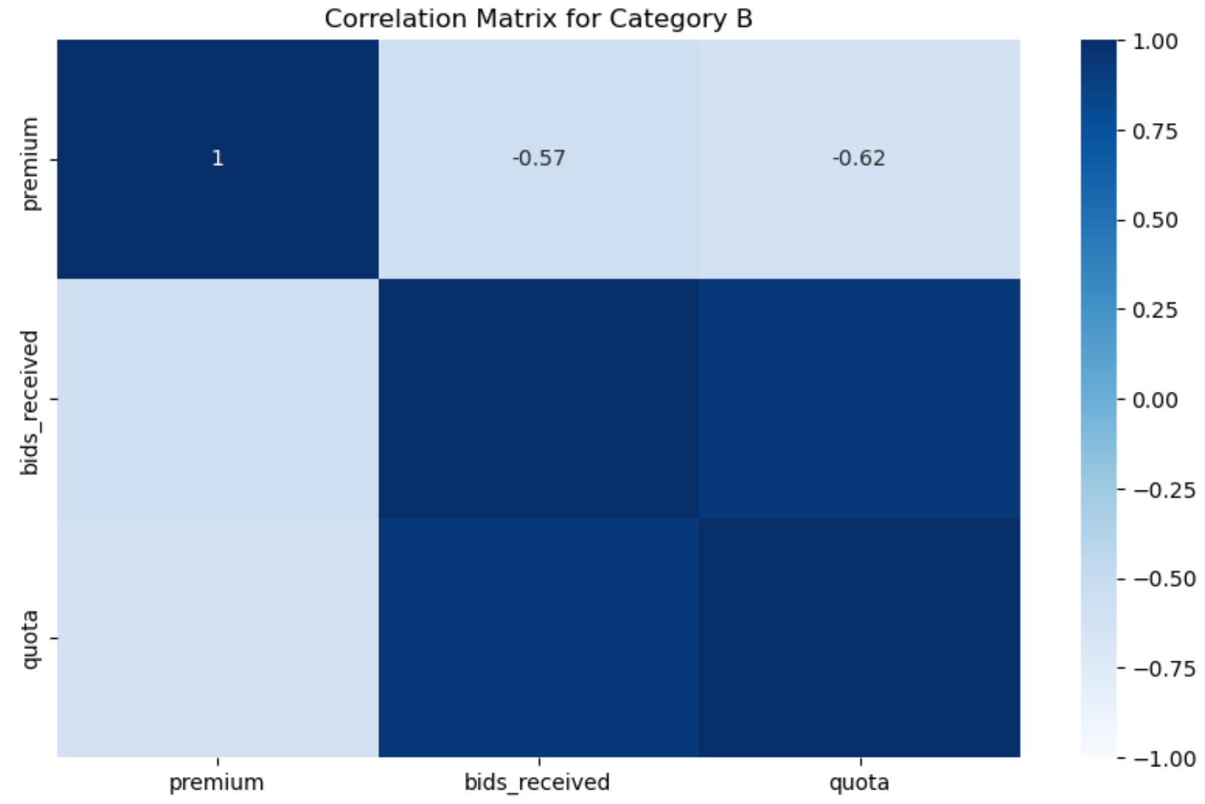
Downwards trending
Negative Pearson correlation coefficient
P-value (Cat A) = 1.12e-20 << 0.05
P-value (Cat B) = 7.02e-38 << 0.05
Quota & Premium are negatively significant related!

Slide 11
Any correlations between period of purchase and COE premium?

Slide 12
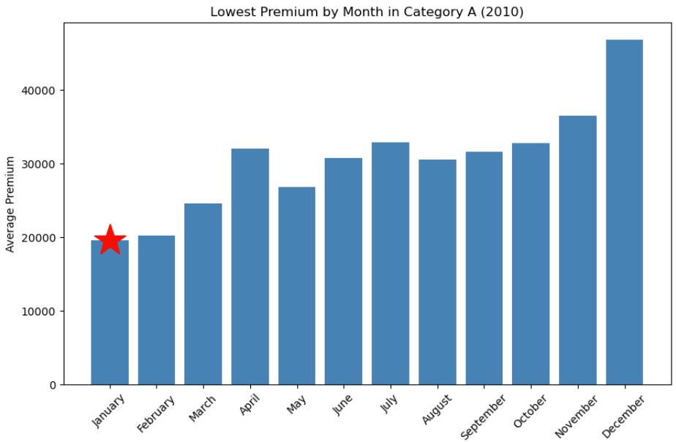
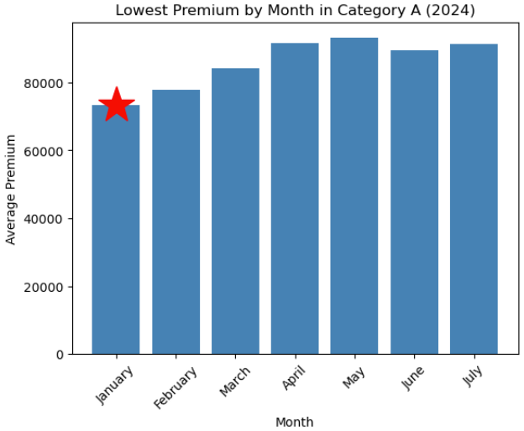
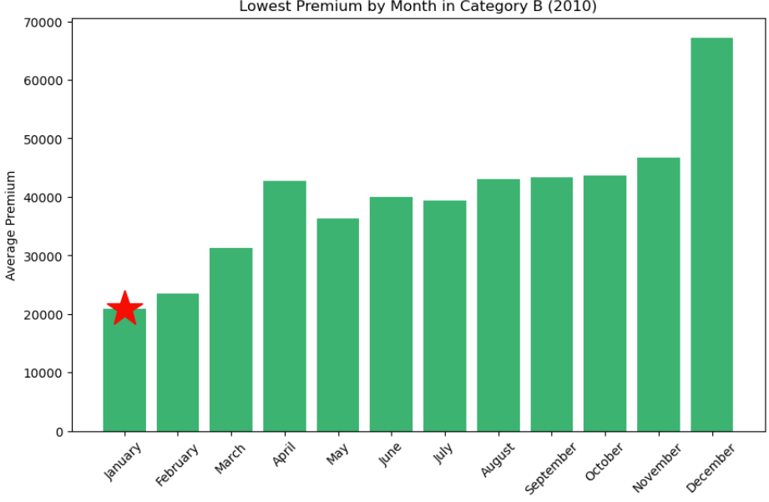
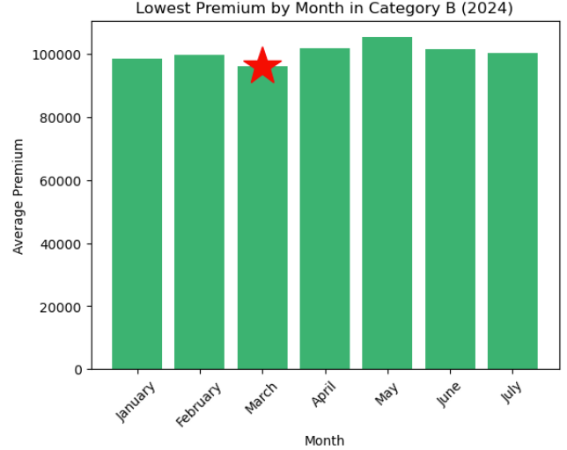
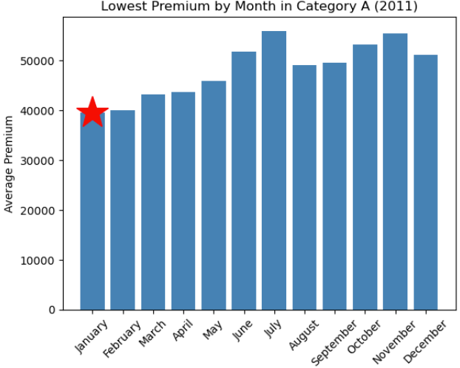
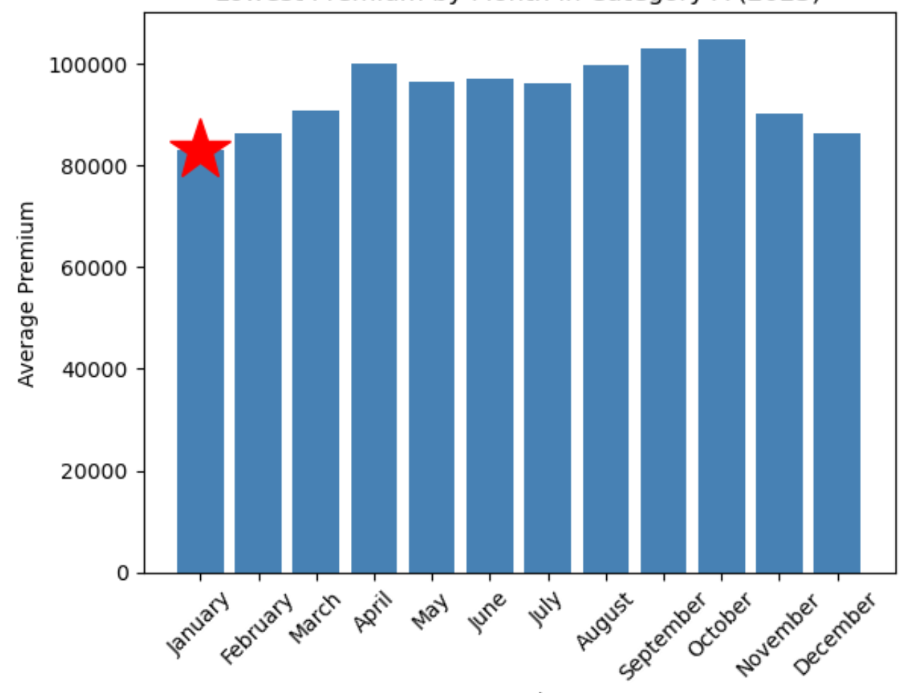
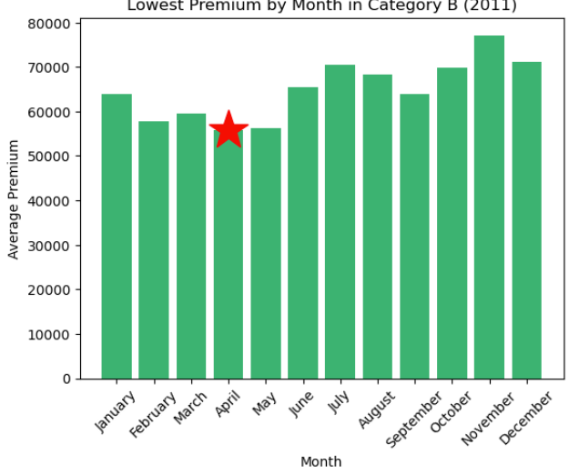
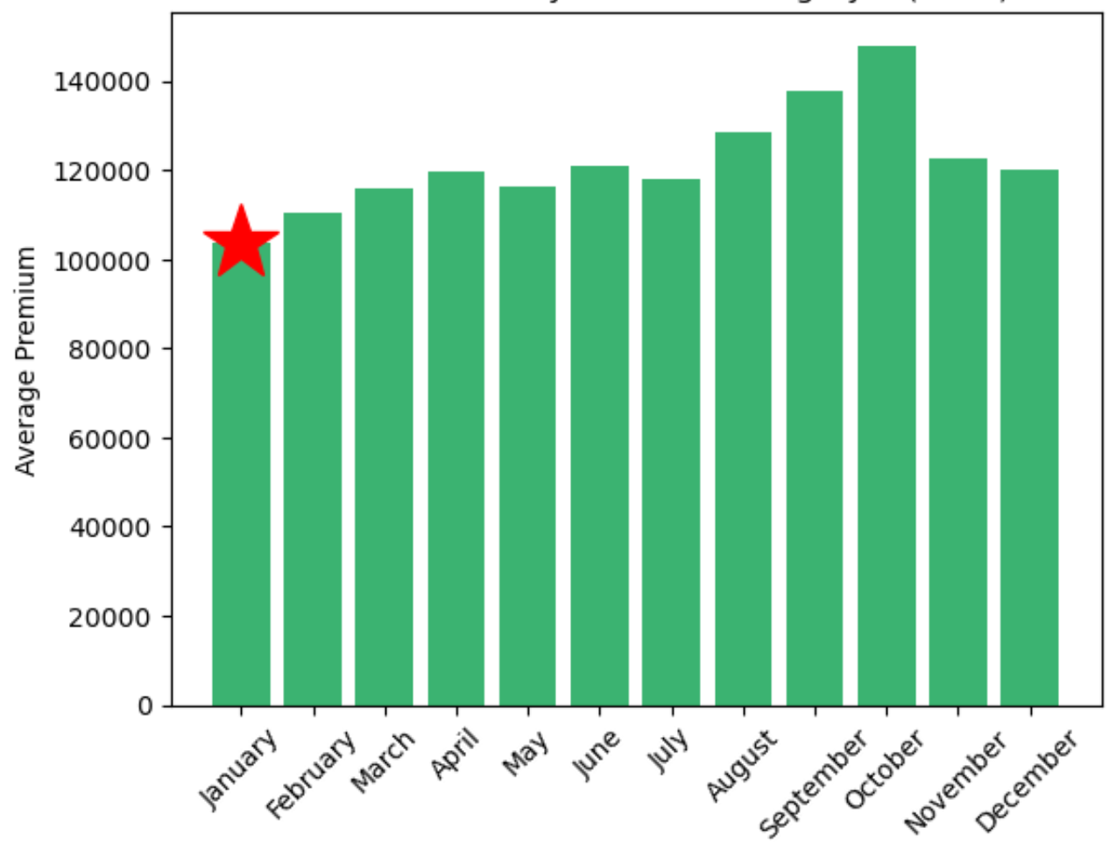
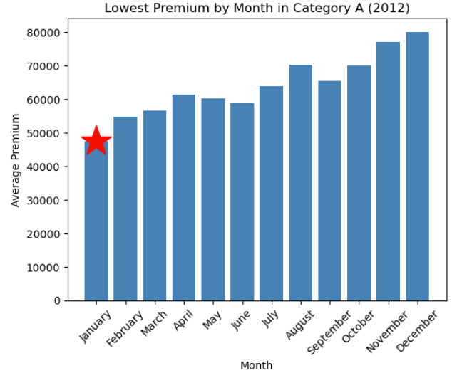
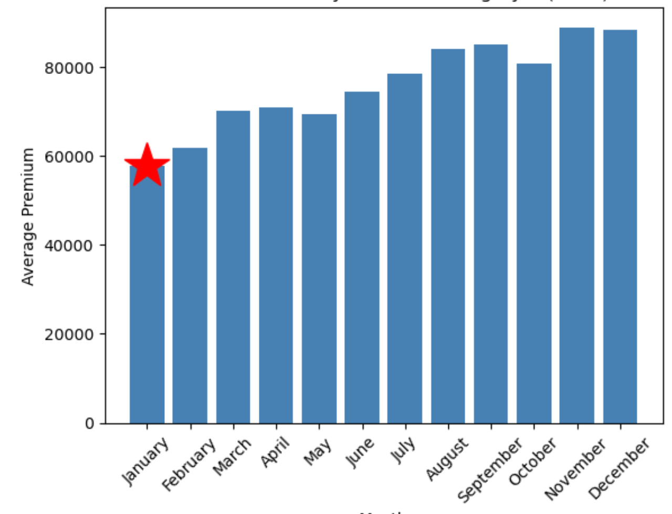
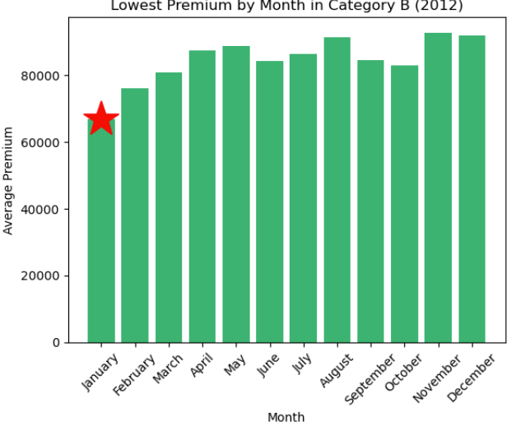
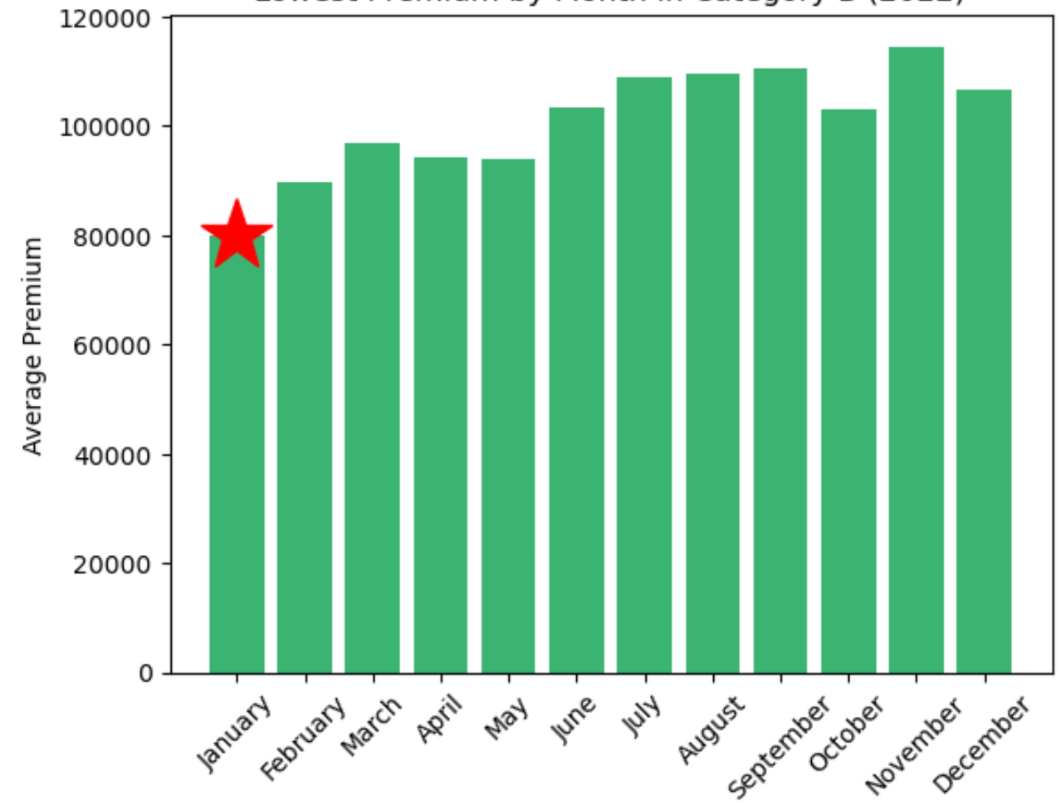
Premium trends YOY
Cat A
Cat B
2010
2024
2010
2024
Start of the year is usually the period where
premium is the LOWEST!
2011
2023
2011
2023
2012
2022
2012
2022

Slide 13

Recommendation
& Limitations

Slide 14







Recommendations & Limitations
Quota vs Premium
Season vs Premium
Lower quota will lead to Higher premium.
Quarterly quota’s information are released 1 month prior to the bidding exercise. (e,g July will release information for Aug – Oct).
Interested buyers could target months with higher quota.
Start of the Year is usually the period with lowest premium.
Interested buyers could target this period of entry.
Limited Data Interpretation
Potential Market Factors
Information may be loss during data cleaning/grouping. More suitable statistical model could be deployed to improve analysis accuracy.
Other external factors, such as economic conditions, government policies, and consumer preferences, could also influence COE premium trends, which are not fully accounted for in the analysis.
While the insights from the analysis provide a useful starting point, it is important to consider the limitations of the data and the assumptions made. Additional research and monitoring of the market conditions would be necessary to make more informed and reliable recommendations for the best time to purchase a car in Singapore.

